Slide 1
Arthur Dove
by Sarah Mataraza

Slide 2
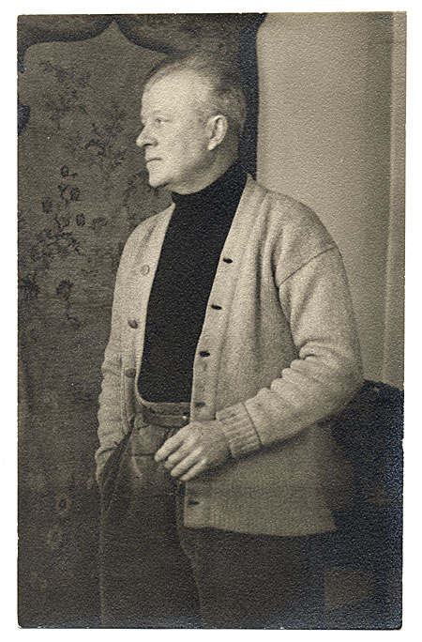
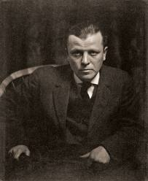
Arthur Dove
Arthur Garfield Dove was born on August 2nd, 18800 in Canandaigua, New York
As a kid, he befriended a neighbor, Newton Weatherby, who took him hunting, fishing, and camping
Weatherby encouraged Dove’s fascination with nature and gave him scraps of canvas to paint on

Slide 3
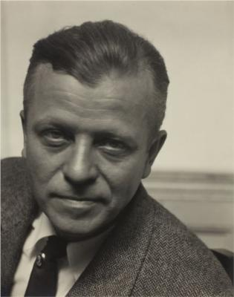
Dove’s Life
Grew up in Geneva, NY
Went to college at Hobart before transferring to Cornell (graduated 1903)
Married his first wife, Florence, in 1904
Moved to NYC where he got a job as an illustrator
Traveled to Paris with his wife in 1908 and stayed there for 15 months
Returned to NY in 1909
Their son, William Dove, was born in 1910

Slide 4
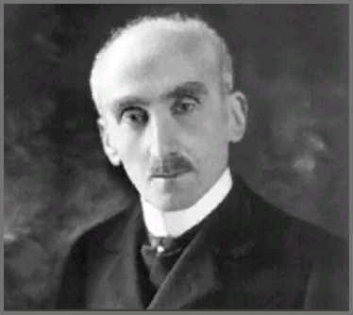
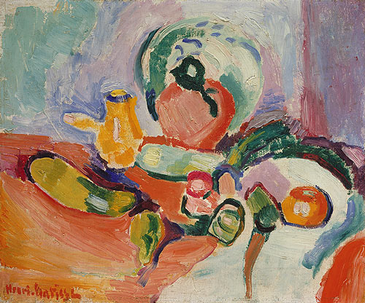
Inspirations
Arthur Dove had a fascination with nature.
He was inspired by the natural cycles of growth and renewal
He also was influenced by Henri Bergson, a French philosopher who stressed the importance of a mystical understanding of the world.
Dove’s abstract style was inspired by the French fauvists and Matisse when he went on a trip to Paris with his first wife in 1908 and 1909.
Henri Bergson
Still Life with Vegetables, 1905–6, Henri Matisse

Slide 5
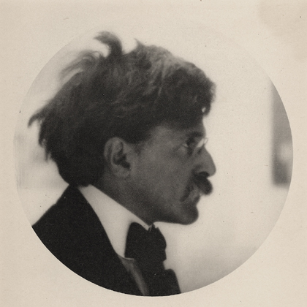
Alfred Stieglitz
Not long after he came back to the US, Dove met Alfred Stieglitz
Stieglitz ran an art gallery which came to be known as 291 in New York where he exhibited American and European modern art
Dove had his first exhibit in 1912 of 10 pastel drawings later named “Ten Commandments”
Stieglitz opened a new gallery “The Intimate Gallery” at the same time Dove began showing regularly

Slide 6
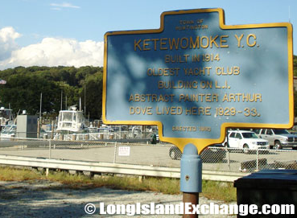
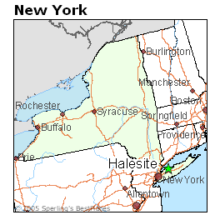
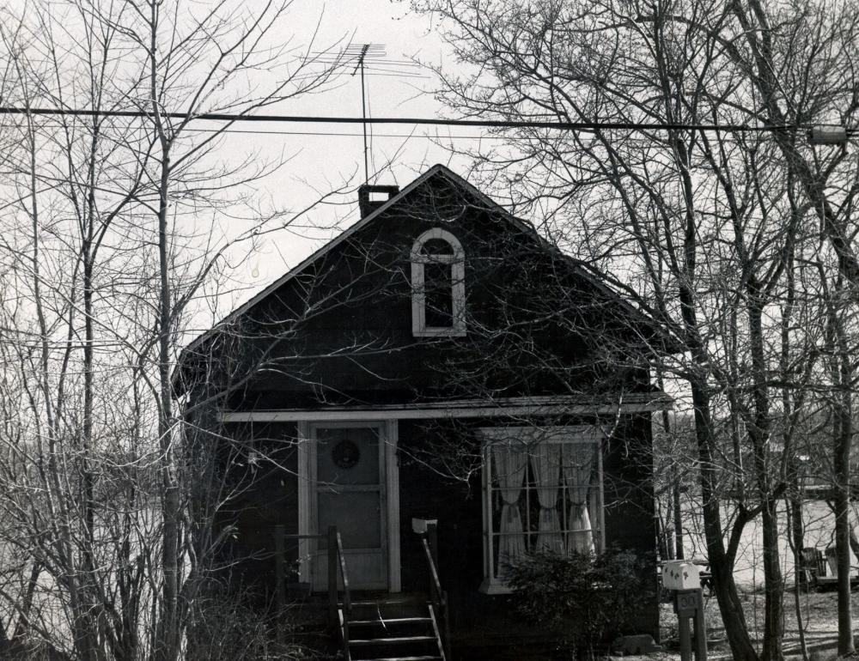
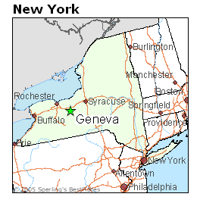
The Stieglitz Circle
After Stieglitz’s gallery was torn down, he opened a new gallery called An American Place
With the new gallery, he focused on a some American artists (Dove, O’Keefe, Marin were a few) - This was the Stieglitz circle
There was another member of the circle named Helen Torr, who went by Reds. Arthur Dove and Helen Torr left both of their marriages for each other in 1922 (eventually, they got married in April 1932) (lived together first in Halesite, NY, and later moved to Geneva, NY

Slide 7
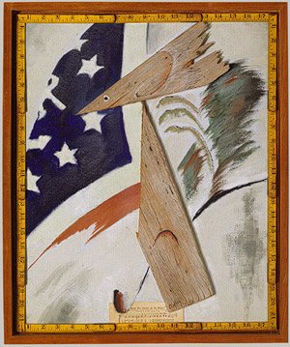
Mediums
Dove mostly used pastels and oil paint on composition board and canvas
Dove also made collages using various materials including: shingles, needlepoint, printed papers, dried leaves, folding rulers, and wood
Some paintings were made using watercolor, gouache, and pencil
Portrait of Ralph Dusenberry, 1924

Slide 8
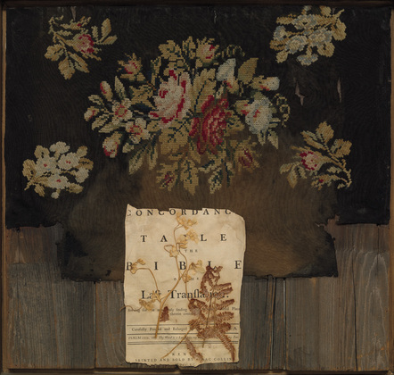
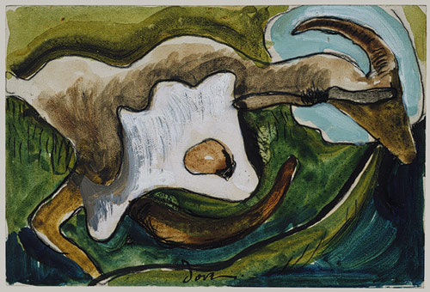
Grandmother, 1925
Goat, c. 1934

Slide 9
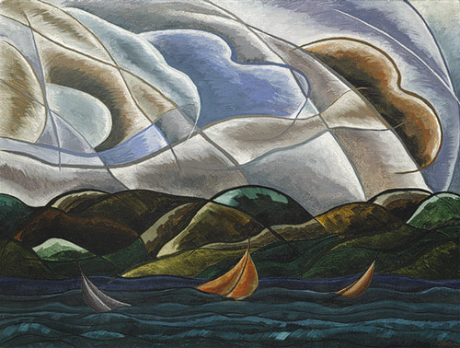
Art Movements
Dove is credited for leading the abstraction in America.
He was also influenced by cubism and expressionism
Dove is also considered an early American Modernist
Clouds and Water, 1930

Slide 10
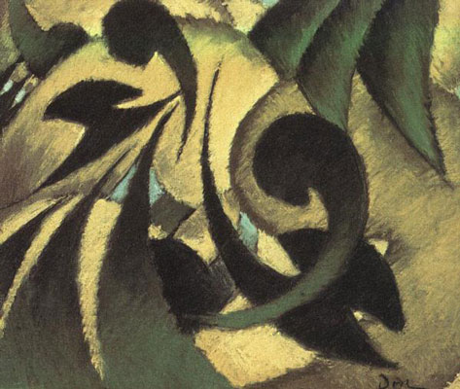
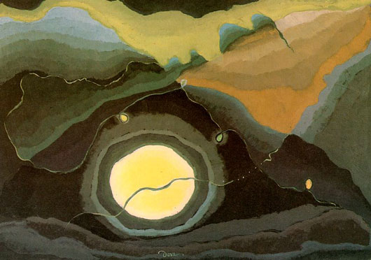
“I look at nature, I see myself. Paintings are mirrors, so is nature.”
Me and the Moon, 1937
Nature Symbolized No. 2 1911

Slide 11
Bibliography
http://www.aaa.si.edu/collections/arthur-and-helen-torr-dove-papers-9318/more
http://www.metmuseum.org/toah/hd/dove/hd_dove.htm

