Slide 1
Frida Kahlo
1907-1954

Slide 2
About Frida
Frida was born July 6, 1907 in the outskirts of Mexico City.
The Mexican Revolution began in 1910, which Frida was three. She later wanted her birth date to coincide with the start of the revolution and the birth of modern Mexico, so she changed her birth to July 7, 1910.
Her mother was a devout Catholic, Frida often rebelled against her mother and felt a stronger bond with her father.
Frida was diagnosed with polio at the age of six, it cause her right leg to be thinner than the left, she covered this by wearing colorful long skirts.
She was also born with spina bifida, a condition that affects both spinal and leg development.

Slide 3
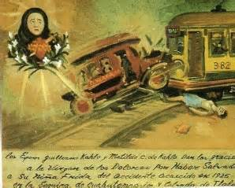
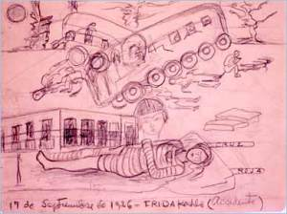
Frida’s Accident
Frida Kahlo suffered a serious accident in her life: in 1925 when a streetcar collided with a bus she was riding in located in Mexico City.
The accident nearly killed her. Doctors were surprised that she survived.
Her accident includes wounds that she will suffer from for the rest of her life.
An iron rod pierced her abdomen, right foot was crushed, and two vertebrae were fractured.

Slide 4
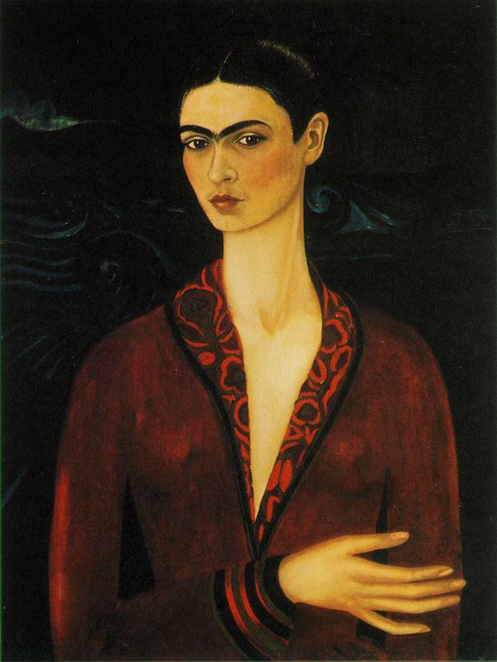
Fridas Early Paintings
She started painting after her accident.
She started by painting family friends portraits and later self portraits.
Her early paintings were dark and gloomy.

Slide 5
Diego and Frida
Diego Rivera was an Mexican muralist, he was large and an unappealing man to most people and Frida admired him.
Frida and Diego were 20 years apart in age.
Fridas mother disapproved of Frida and Diego's marriage. She didn’t agree because Diego was Atheist, also because he was old and fat saying that there arrangement is like “the elephant and the dove”
Their marriage was full of affairs on both sides.
They got married in 1929, then with countless affairs the couple divorced in 1939 and a year later remarried.

Slide 6
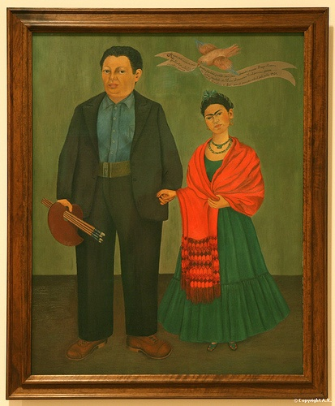
Wedding Portrait 1931
This painting was made right after their wedding.
They stand there looking awkward like a new couple.
Diego is holding paint brushes representing himself more as a muralist. He is facing away from Frida shows no love.
Frida faces her body towards him and tilts her head showing signs that she loves him.
Both of them aren’t smiling.

Slide 7
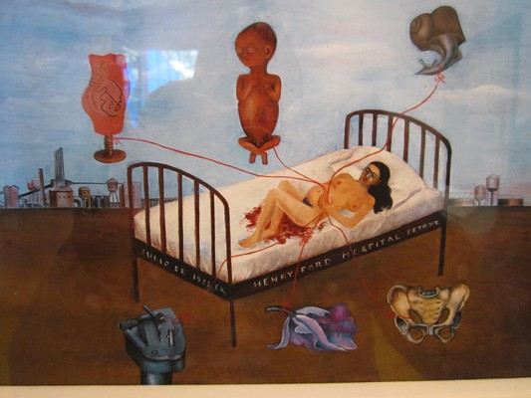
Henry Ford Hospital, 1932
The six strands are connected to Frida representing veins
First, a model of a female torso
Second, a male fetus Frida had hoped to have a boy
A sewing machine, standing for piercing pain.
A snail, for the slowness of the miscarriage
An orchid, representing a uterus and also the flower that Diego brought to her in the hospital
A pelvis, standing for bone fractures that made childbirth impossible

Slide 8
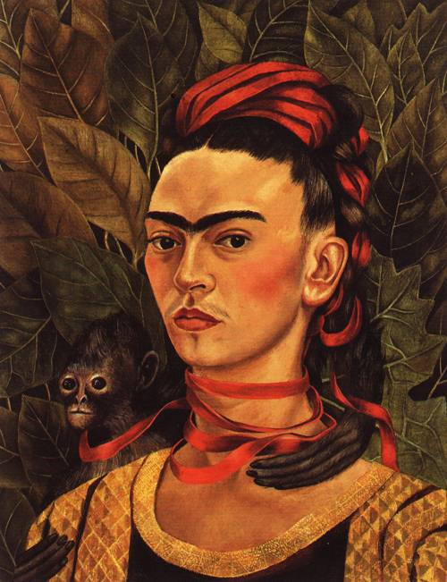
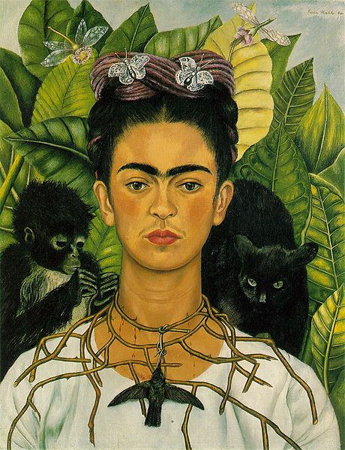
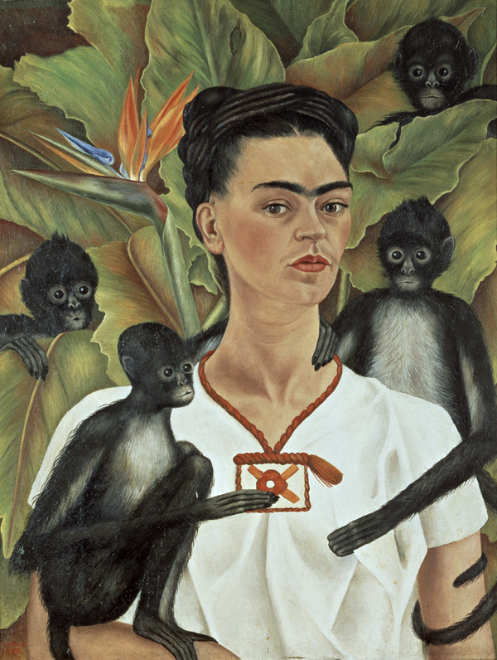
The monkeys and sometimes birds and other animals in Fridas paintings represent her unborn children.
In some the monkeys feel like a part of her.

Slide 9
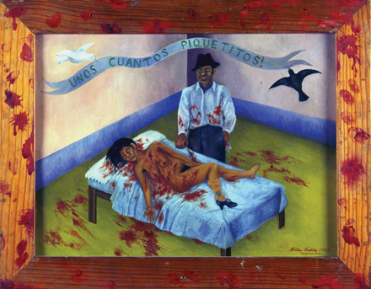
But it was only a few small nips!
Frida found out that her husband Diego had been cheating on her with her sister.
This destroyed Frida, this led to Frida not painting and their divorce.
This painting was one of the first things Frida painted since Diego's betrayal
This painting was inspired by a local murder. It's of a man who stabbed his girlfriend 20 times.
This was Fridas way to show the way women were treated in Mexico, women were voiceless victims.
This is also how Frida felt by Diego.

Slide 10
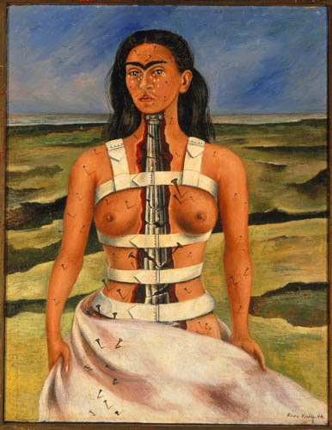
The Broken Column
This painting was made soon after Frida's spinal surgery
The column is representing her broken spine
The nails pinned all over her body are standing her pain

Slide 11
Video
http://www.biography.com/people/frida-kahlo-9359496#synopsis

Slide 12
Bibliography
Alacantara, Isabel and Egnoff, Sandra. Frida Kahlo and Diego Rivera. Munich, London, New York: Prestel Verlag 1999.
Chadwick, Whitney, ‘The Muse as Artist: Women in the Surrealist Movement’, Art in America, Vol. 73, July, 1985, 120 - 129.
Hardin, Terri. Frida Kahlo: A Modern Master. New York: Smithmark Publishers, 1997.
Wach, Ken. Frida Kahlo and the Imagery of Tragedy. The University of Melbourne: Double Dialogues. Anatomy and Poetics: Issue Six, 2005.

