Slide 1
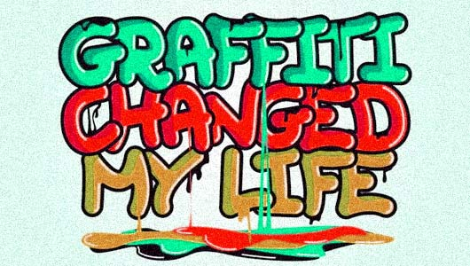
BY Matthew Plattner

Slide 2
Where it all started
Graffiti has been around for centuries, from the painted caves in France by cave men and women to the spray paint graffiti we think of today.
The main graffiti movement we see toady started back around 1960’s in Philadelphia. A few guys started the bombing scene. Guys named COOL EARL and CORNBREAD. A more commonly reconized writer that we know of is Taki 183. Taki is a nickname and 183 is the street number which he lived on. No one can really pin point the excatct person that started it all, it just happened.

Slide 3
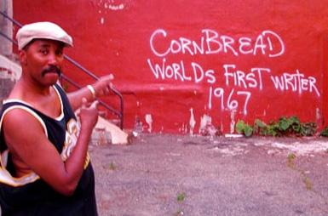
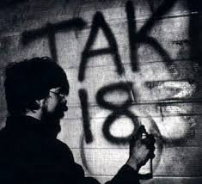
The graffiti associated with hip-hop most likely got started sometime in the mid-to-late 1960s.
Taki 183 was one who was recognized to start the tagging and writing movement. Other people saw

Slide 4
Time Line
BCE
C.60,00 Humans starts to paint on cave walls
C. 3300 Picture writing is invented in the middle East
C. 3100 Egyptian builders carve graffiti into stone quarries
C. 3000 The first carvings are made on rocks in Saudi Arabia
C. 750 Roman towns and cities have many examples of carved graffiti
C. 200 The mayans carved graffiti onto walls in the city of Takal, located in modern-day Mexico
C. 790 Vikings from Scandinavia begin their raids on Europe, They leave examples of carved graffiti
C. 800 European builders and soldiers carve graffiti on castle and cathedral walls
C. 1350 Italian artists carve their names on ancient Roman monuments
C. 1800 Tourism becomes popular, they start to carve names on monuments
C. 1939 World War II begins, American soldiers carve and paint graffiti in Europe and the Far East
C. 1949 Edward Seymour invents canned spray paint
C. 1960 Gangs in U.S cities start painting tags. Hip-Hop begins in New York City
C. 1981 Artist Blek le rat starts creating stencil graffiti in Paris, France

Slide 5
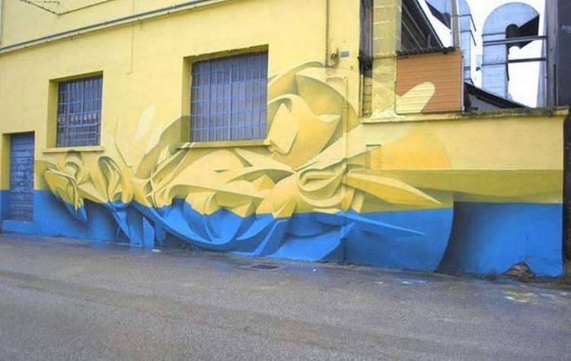
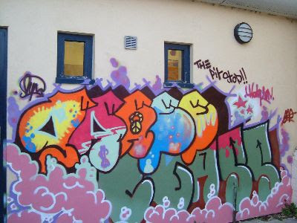
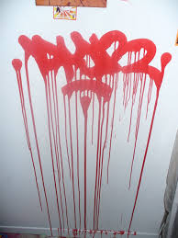
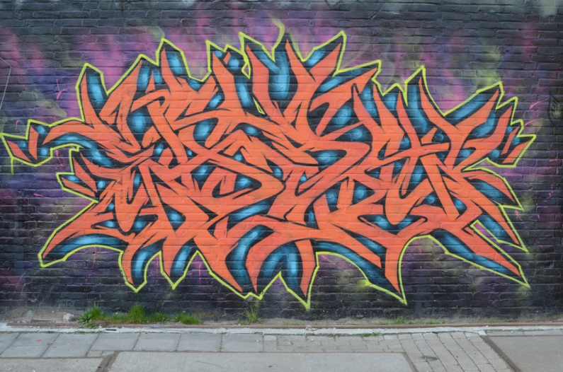
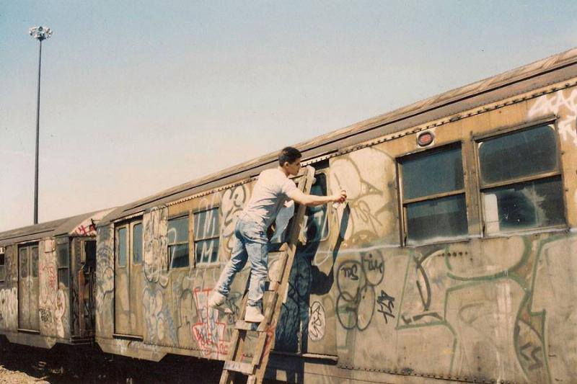
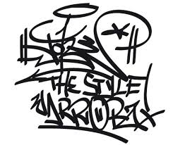
What are the different Styles?
3D
Bubble
TAGS
Wild Style
Old School

Slide 6
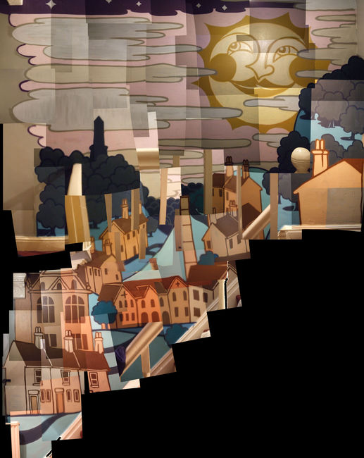
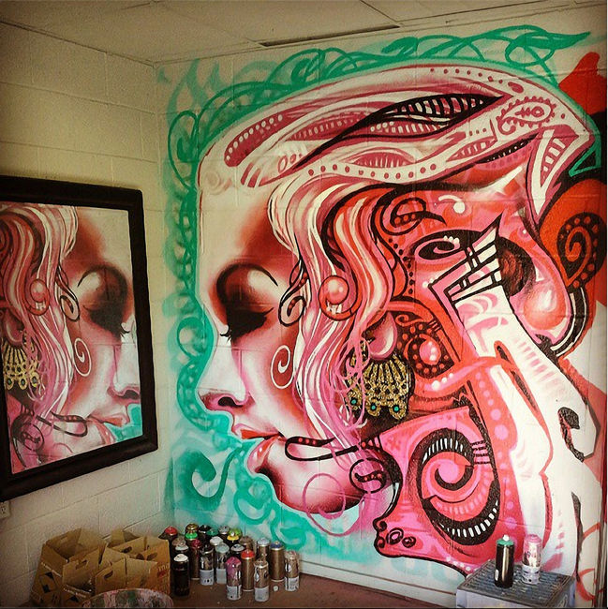
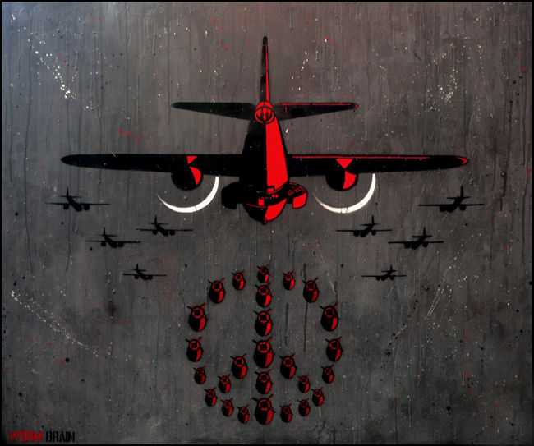
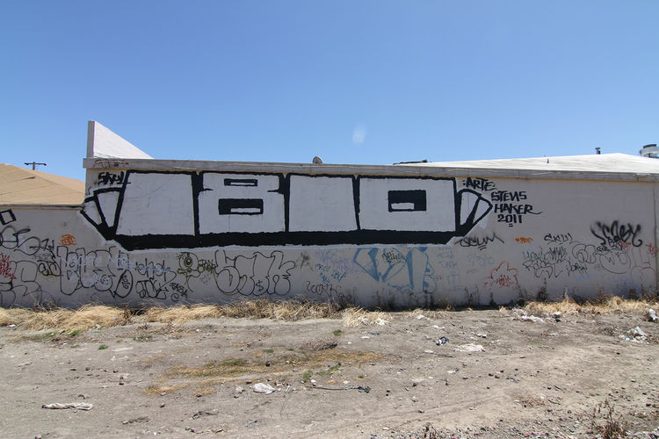
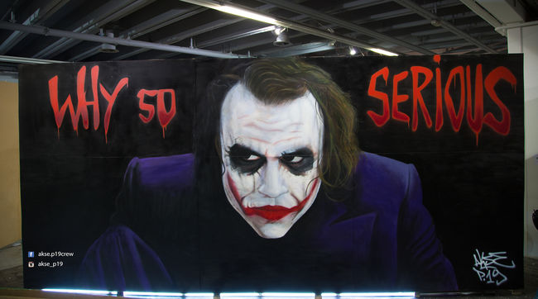
Landscape
Abstract
Stencil
BLOCK
Realistic

Slide 7
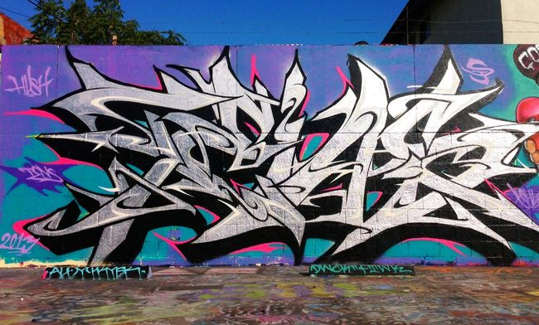
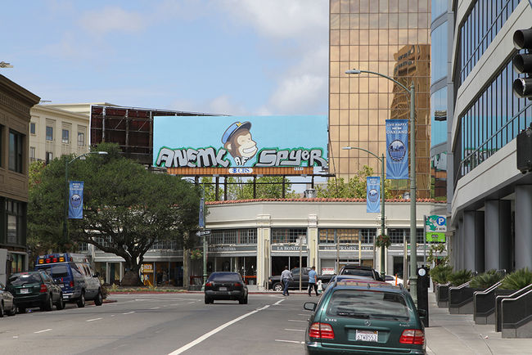
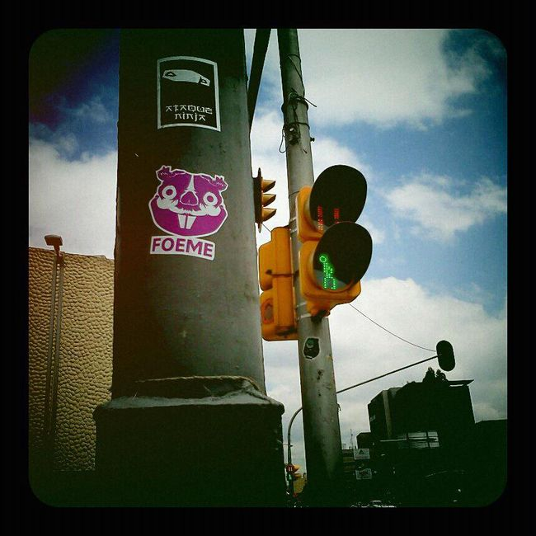
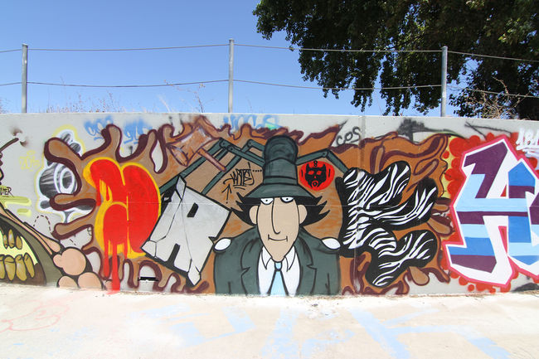
Billboard
Sharp
Sticker
Cartoon

Slide 8
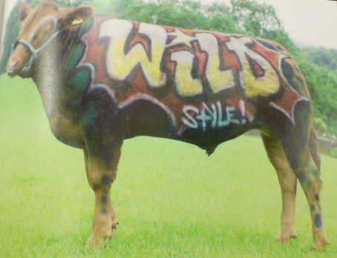
Materials and Mediums
Mediums
Walls-Brick, Concrete , Wood, Metal
Signs
Canvas
Paper
Sticker
Bridges
Anything you could think of writing on!

Slide 9
Mediums
Spray Paint
Paint-Brush, Markers, splatter
Pens
Pencil
Markers
Stickers
Scratching, edging tools

Slide 10
Subject Matter
Graffiti has no limit to the subject matter, graffiti contains everything from a landscape scene to a cartoon character.
Graffiti is so creative, you can use make whatever you want. It doesn’t have to mean anything, just could have a nice flow or look.

Slide 11
Bibliography
http://www.daveyd.com/historyofgraf.html
http://www.at149st.com/history.html

